Slide 1
Help Restore Hope Center
Liberty Resources
Dynamics of Domestic Violence

Slide 2
What is Domestic Violence?
Domestic violence is the willful intimidation, physical assault, battery, sexual assault, and/or other abusive behavior as part of a systematic pattern of power and control perpetrated by one intimate partner against another. It includes physical violence, sexual violence, psychological violence, and emotional abuse. The frequency and severity of domestic violence can vary dramatically; however, the one constant component of domestic violence is one partner’s consistent efforts to maintain power and control over the other.
Violent or aggressive behavior within the home or relationship, typically involving physical, emotional or verbal violence towards a partner, children or family member.
Domestic Violence is rarely an isolated incident. Abusers use a series of tactics to maintain control. A person does not have to experience physical violence for there to be abusive power and control in a relationship.

Slide 3
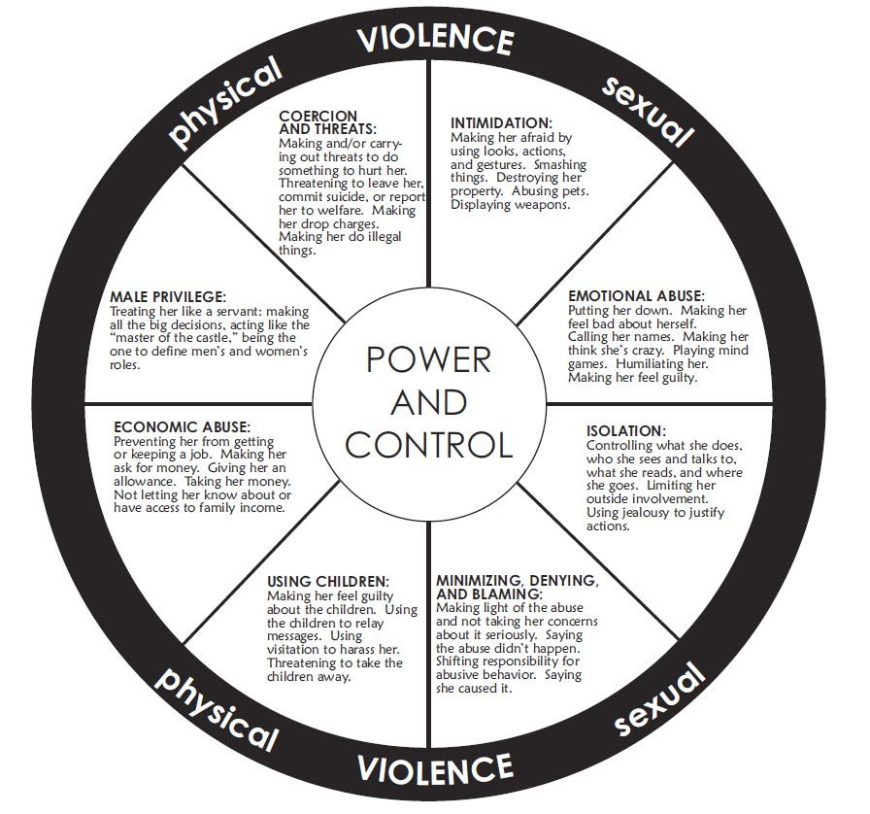
Power and control
The wheel illustrates, abuse is cyclical. There are periods of time where things may be calmer, but those times are followed by a buildup of tension and abuse, which usually results in the abuser peaking with intensified abuse. The cycle then often starts to repeat, commonly becoming more and more intense as time goes on. Each relationship is different and not every relationship follows the exact pattern. Some abusers may cycle rapidly, others over longer stretches of time. Regardless, abusers purposefully use numerous tactics of abuse to instill fear in the victim and maintain control over them.

Slide 4
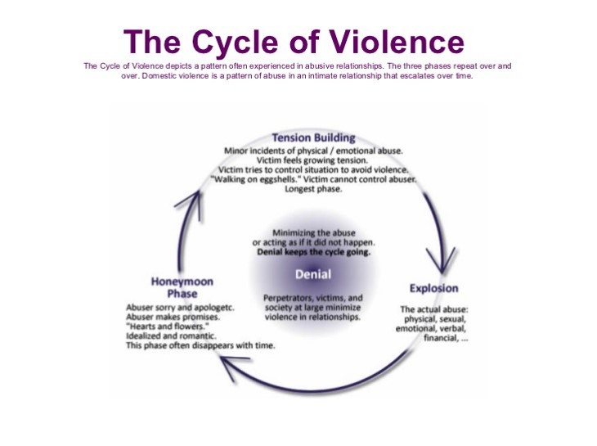
Cycle of abuse

Slide 5
Forms of Domestic Violence include:
• Battery/Physical Abuse – a pattern of abusive behavior that a person fearful of their physical and/or sexual safety; control; intimidation; coercion.
• Isolation – forcing a partner to account for their time and whereabouts and/or making a partner tell with whom they have visited; telling a partner that you exist for him only – you do not get to be a separate, autonomous person.
• Emotional Abuse – playing on a partner’s insecurities; giving mixed messages; constant insults and degradation; telling a partner who they are or should be.
• Financial Abuse – controlling all monetary resources; exploiting a partner’s social security number or credit; not allowing a partner access to money or financial documentation.
• Threat of Control of the Children - a partner must acquiesce to the abuser’s needs, wants or desires or something will happen to the children; threat of taking the kids away.

Slide 6
Characteristics of Victims and Why Victims May Use Force of Violence within an Intimate Relationship
Anyone can be a victim of domestic violence. There is NO “typical victim.” Victims of domestic violence come from all walks of life, varying age groups, all backgrounds, all communities, all education levels, all economic levels, all cultures, all ethnicities, all religions, all abilities and all lifestyles.
Over time, the victim becomes more and more oppressed by the abuser and may do whatever they can to not agitate or displease their partner. In other instances, victims of violence often retaliate and resist domination and battering by using force themselves. Victims may use violence or force in effort to:
  Escape and/or stop violence that is being perpetrated against them, and
  Establish a semblance of equivalence in the relationship as a method of protecting themselves and their children against escalating abuse.
In relationships where domestic violence exists, violence is not equal, even if the victim fights back or instigates violence in effort diffuse a situation. Violence on victims’ part is in larger part resistance to ongoing battering.

Slide 7
A victim’s reactions to abuse fall into three classes:
• Coping (e.g., placating the abuser, enduring, etc.),
• Managing (e.g., anticipate abusers’ moods, modify own behavior so as not to arouse anger in abuser, attempt to control situations that lead to violence, divert attention from the abuse through religion or other activities, etc.), and
• Resisting (e.g., create consequences for abuser such as arrest, seek outside help, hit back or strike preemptively, take other overt and covert actions to end or escape the abuse, etc.).
Domestic violence affects all aspects of a victim’s life. When abuse victims are able to safely escape and remain free from their abuser, they often survive with long-lasting and sometimes permanent effects to their mental and physical health; relationships with friends, family, and children, their career and their economic well-being.

Slide 8
What Does Abuse Include?
Abuse may begin with behaviors that may easily be dismissed or downplayed such as name-calling, threats, possessiveness, or distrust. Abusers may apologize profusely for their actions or try to convince the person they are abusing that they do these things out of love or care. However, violence and control always intensifies over time with an abuser, despite the apologies. What may start out as something that was first believed to be harmless (e.g., wanting the victim to spend all their time only with them because they love them so much) escalates into extreme control and abuse (e.g., threatening to kill or hurt the victim or others if they speak to family, friends, etc.).
Some examples of abusive tendencies include but are not limited to:
Telling the victim that they can never do anything right
Showing jealousy of the victim’s family and friends and time spent away
Accusing the victim of cheating
Keeping or discouraging the victim from seeing friends or family members
Embarrassing or shaming the victim with put-downs
Controlling every penny spent in the household
Taking the victim’s money or refusing to give them money for expenses

Slide 9
Looking at or acting in ways that scare the person they are abusing
Controlling who the victim sees, where they go, or what they do
Dictating how the victim dresses, wears their hair, etc.
Stalking the victim or monitoring their victim’s every move (in person or also via the internet and/or other devices such as GPS tracking or the victim’s phone)
Preventing the victim from making their own decisions
Telling the victim that they are a bad parent or threatening to hurt, kill, or take away their children
Threatening to hurt or kill the victim’s friends, loved ones, or pets
Intimidating the victim with guns, knives, or other weapons
Pressuring the victim to have sex when they don’t want to or to do things sexually, they are not comfortable with
Forcing sex with others
Refusing to use protection when having sex or sabotaging birth control
Pressuring or forcing the victim to use drugs or alcohol
Preventing the victim from working or attending school, harassing the victim at either, keeping their victim up all night so they perform badly at their job or in school
Destroying the victim’s property

Slide 10
Physical abuse
Physical abuse is an act where one person uses their body physical, inflict intentional harm or injury upon another person. Forms of Physical Abuse
Another form of physical abuse sometimes brushed aside as nothing too major is hair pulling. While siblings sometimes do this when they're fighting, that doesn't make it right, especially when its adults involved and it's still a form of physical abuse, nonetheless.
Furthermore, do not assume physical abuse always has to involve direct contact. Some forms of physical abuse are indirect. For example, someone may spit at you. Yes, they didn't directly hit you but spitting at someone is still a physical act. Worse, they may throw an object at you, like a chair. Again, direct body-to-body contact didn't occur but the act itself is highly and aggressively physical, nonetheless.
Additionally, physical abuse can entail something else we don't think about as being stereotypically physically abusive. For instance, if a person forces you to swallow something that hurts you, like a chemical or even a medication you don't need, that is physical abuse as well. They may not have hit you but what they forced you to do is physically abusive.

Slide 11
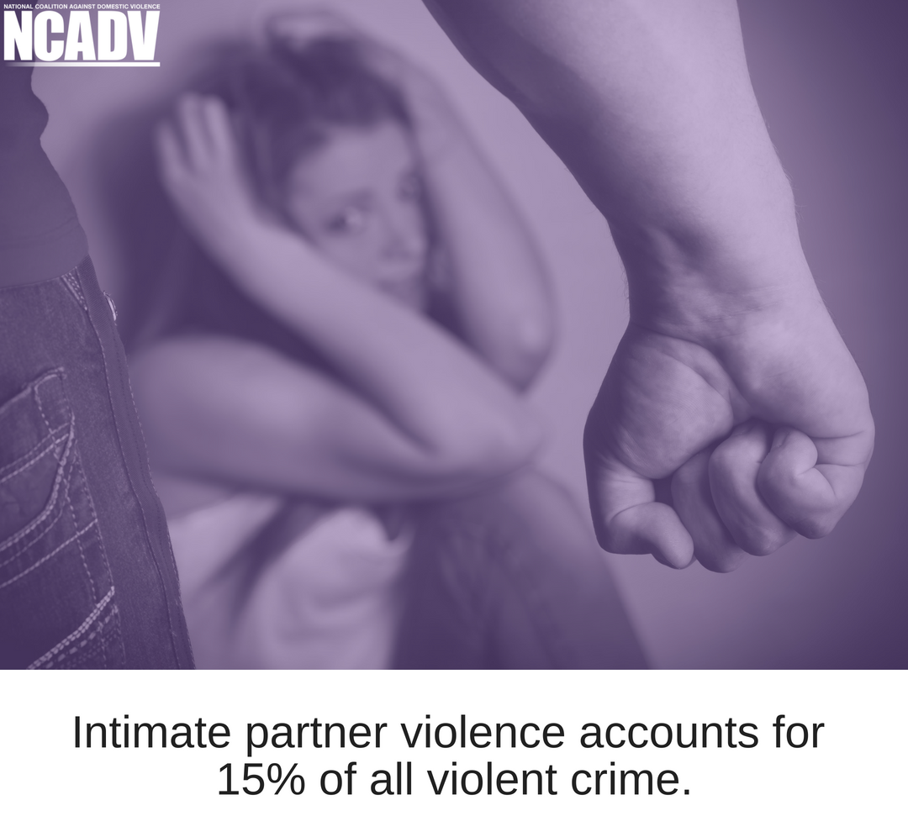
Other, more obvious, forms of physical abuse you're probably more familiar with include:
Punching
Kicking
Shaking
Suffocating
Pinching
Hitting/Slapping
Scratching
Scalding or burning someone

Slide 12
Verbal abuse
Verbal abuse is also known as “verbal bullying” because it is the act of directing negative statements toward someone, causing emotional harm. Verbal abuse consists of behaviors that are non-physical, but which can still be rather damaging, such as being threatening, insulting, or humiliating toward someone. Those who are verbally abusive tend to be so because they believe it will give them more power and control in the relationship. Any of the following actions can be considered forms of verbal abuse:
Screaming/yelling/threatening
Swearing/Accusing/blaming
Name-calling and/or using insulting words
Ordering the victim around
Judging/criticizing
Abusive anger
Discounting or minimizing the victim’s experiences
Verbal abuse is a form of emotional abuse. People have suffered verbal abuse from their bosses, their loved ones, and even perfect strangers. Just because verbal abuse does not leave a physical scar does not mean that it did not deeply hurt the victim. Verbal abuse can also refer to what is not said. A lack of response from an abuser to something the victim has said makes the victim feel as if he or she does not even exist or does not “deserve” an answer.

Slide 13
What’s the difference between verbal abuse and a ‘normal’ argument?
We all get into arguments from time to time. Sometimes we lose our cool and yell. It’s all part of being human. But verbal abuse isn’t normal. The trouble is, when someone is involved in a verbally abusive relationship, it can seem normal to them.
Here are some examples of what normal disagreements look like:
  They don’t dissolve into name-calling or personal attacks.
  They don’t happen every day.
  Arguments revolve around a basic issue. They aren’t character assassinations.
  You listen and try to understand the other’s position, even when you’re angry.
  One of you may yell or say something truly awful out of frustration, but it’s an unusual occurrence and you work through it together.
Consider it a red flag when the other person engages in these behaviors:
  They insult or attempt to humiliate you. Then they accuse you of being overly sensitive or say that it was a joke, and you have no sense of humor.
  They frequently yell or scream at you. You get blamed for starting the argument.
  The initial disagreement sets off a string of accusations and dredging up of unrelated issues to put you on the defense.

Slide 14
EMOTIONAL OR PSYCHOLOGICAL ABUSE
Emotional or psychological abuse (terms often used interchangeably) involves trauma to the victim caused by verbal abuse, acts, threats of acts, or coercive tactics. Perpetrators use emotional or psychological abuse to control, terrorize and denigrate their victims. It frequently occurs prior to or concurrently with physical or sexual abuse.
Emotional or psychological abuse includes:
• Humiliating the victim
• Controlling what the victim can/cannot do
• Withholding information from the victim
• Deliberately doing something to make the victim feel diminished/embarrassed
• Isolating the victim from friends/family
• Denying the victim access to money or other basic resources
• Stalking
• Denigrating the victim in public or in private

Slide 15
• Undermining the victim’s confidence and/or sense of self-worth
• Convincing the victim (s)he is crazy
• Other forms of verbal abuse
Emotional abuse is the most common form of control and can often exist in relationships where there is not physical violence.
  “Gas lighting” - A manipulative tactic in which a person, to gain power and control of another individual, plants seeds of uncertainty in another person's mind.
  Examples of Gaslighting comments:
  You're overreacting, you need help, I didn’t do that, you're upset over nothing, you must be confused again, just calm down, you’re so dramatic, I never said that, why are you so defensive, it’s your fault, I was just joking, it’s always something with you.

Slide 16
Economic and Financial Abuse
WHAT IS ECONOMIC ABUSE?
Economic abuse involves maintaining control over financial resources, withholding access to money, or attempting to prevent a victim/survivor from working and/or attending school in an effort to create financial dependence as a means of control. Victims and survivors are often forced to choose between staying in abusive relationships and poverty or even homelessness. Economic abuse is a very common reason victims stay in abusive relationships. Economic abuse can take many forms, including:
Employment-related abuse prevents the victim from earning money by:
• Preventing victim from going to work
• Sabotaging a victim’s employment
• Interfering with a victim’s work performance through harassing activities such as frequent phone calls or unannounced visits
• Demanding that the victim quits his/her job
• Preventing the victim from looking for jobs or attending job interviews

Slide 17
Other forms of economic abuse include:
• Intentionally withholding necessities such as food, clothing, shelter, personal hygiene
products and/or medication
• Refusing to pay court-ordered child or spousal support
• Stealing and/or destroying the victim’s belongings
• Requiring justification for any money spent and punishing the victim with physical, sexual
or emotional abuse
• Repeatedly filing costly lawsuits
WHY IT MATTERS
Victims of domestic violence may be unable to leave an abusive partner or may be forced to return to an abusive partner for economic reasons. Victims of coerced debt may face massive barriers to economic self-sufficiency, including struggling to find a job or even obtaining a place to live after leaving an abusive relationship due to debt
and its detrimental effects on their personal credit scores.

Slide 18
Economic effects
Victims of intimate partner violence lose a total of 8,000,000 days of paid work each year, the equivalent of 32,000 full-time jobs.
• Intimate partner violence is estimated to cost the US economy between $5.8 billion and $12.6 billion annually, up to 0.125% of the national gross domestic product.
• Between 21-60% of victims of intimate partner violence lose their jobs due to reasons stemming from the abuse.
• Between 20018 and 2020, 142 women were murdered in their workplace by former or current intimate partners. This amounts to 22% of workplace homicides among women.

Slide 19
Domestic Violence & Children
THE IMPACT OF DOMESTIC VIOLENCE ON CHILDREN
Domestic violence creates a violent and hostile environment that can have devastating effects on children, both physical and emotional. Children who have been exposed to domestic violence can become fearful and anxious, concerned for themselves, their siblings and their parents. Children exposed to violence may have difficulty paying attention in school and experience depression and withdrawal. They may blame themselves for the abuser’s actions or blame the victim. In the long run, children who witness or experience violence at home are much more likely to perpetuate the cycle of abuse in their own relationships as they grow into adulthood.
• Approximately 1 in 5 children witness intimate partner violence in their lifetimes.
• Witnessing intimate partner violence is associated with other forms of violence. Almost 60% children who witnessed domestic violence also experienced child maltreatment in their lifetimes.
• Children’s immediate reaction to experiencing domestic violence include generalized anxiety, sleeplessness, aggression, difficulty concentrating, nightmares, bed-wetting, and separation anxiety.

Slide 20
LONG-TERM IMPACT ON CHILDREN
• Children who witness intimate partner growing up are three times as likely as their peers to engage in violent behavior and to be engaged in a variety of violent and non-violent crime.
• Children raised in abusive homes learn that violence is an appropriate way to solve conflict.
• Children who witness incidents of domestic violence (a form of childhood trauma) are at greater risk of serious adult health problems including obesity, cancer, heart disease, depression, substance abuse, tobacco use and unintended pregnancies than peers who did not witness domestic violence.
CHILD CUSTODY
• Fathers who batter the mothers of their children are twice as likely to seek sole custody of their children as non-abusive fathers.
• Abusive parents use child custody as a way to continue to threaten and harass the victim.
• Because an abuse victim is less likely to be able to afford legal representation, they are at an automatic disadvantage when involved in a child custody case.

Slide 21
HOW ARE PET ABUSE AND DOMESTIC VIOLENCE RELATED?
Pets are often targets of domestic violence. Abusers frequently threaten, injure or kill their intimate partner’s or children’s pets to exert power and coercive control over their victim. Because victims understand the extent of the harm their abusers are likely to inflict upon their pets, many hesitate to leave violent relationships out of concern for their pets’ safety. Recognizing this, an increasing number of shelters have added on-site animal housing or instituted ‘safe haven’ animal foster care programs to protect victims, their children and their pets.
BARRIERS TO SEEKING SERVICES
• Although this is changing, many domestic violence shelters cannot accommodate pets, so survivors may be forced to choose between their safety and that of their beloved companion animals.
• A survey of survivors found that 65% of respondents reported that concerns about their pets’ safety impacted their decision to enter a shelter, with 88% of these reporting they delayed seeking shelter as a result.
• Up to 40% of domestic violence victims remain in abusive relationships, because they cannot find alternative living situations for their pets.
• 52% of pet owners in shelters are forced to leave their pets with their batterers.

Slide 22
DATING VIOLENCE
Domestic violence occurs in dating relationships as well as marriages. Women aged 16 to 24 experience domestic violence at the highest rate of any age group, almost 3 times the national average.
Federal law and many state laws define domestic violence as abuse perpetrated by a current or former spouse, co-habitant, or co-parent. This leaves dating partners without protections afforded to other current or former intimate partners, including access to protective orders and protection from gun violence.
The rate of marriage has declined steeply over the last fifty years. People, particularly young people, are dating longer than in previous generations. As people get married later in life, dating violence will continue to rise.
Given the prevalence of domestic violence within these dating relationships and a shift in the structure of relationships today, communities must work together to ensure that victims of dating violence have access to resources and an increase in legal protections.

Slide 23
Statistics
On average, nearly 20 people per minute are physically abused by an intimate partner in the United States. In one year, this equates to more than 10 million women and men.
1 in 3 women and 1 in 4 men have been victims of [some form of] physical violence by an intimate partner within their lifetime.
1 in 4 women and 1 in 7 men have been victims of severe physical violence by an intimate partner in their lifetime.
1 in 7 women and 1 in 18 men have been stalked by an intimate partner during their lifetime to the point in which they felt very fearful or believed that they or someone close to them would be harmed or killed.
On a typical day, there are more than 20,000 phone calls placed to domestic violence hotlines nationwide this is about 13 calls every minute.

Slide 24
DOMESTIC VIOLENCE IN NEW YORK
• 31.7% of New York women and 29% of New York men experience intimate partner physical violence, intimate partner sexual violence and/or intimate partner stalking in their lifetimes.
• In 2021, New York City law enforcement responded to 250,447 domestic incident reports; police outside of New York City responded to 182,893 domestic incidents.
• There were 59 intimate partner homicides in New York in 2021, comprising 44% of female and 2% of male homicide victims 16 years of age or older. 40% were committed using firearms.
• In 2021, 228,769 protective orders were entered into New York’s Order of Protection Registry.
• In 2021, non-residential domestic violence programs served 39,458 survivors, and residential programs served 5,969 adults and 6,105 children. 12,269 requests for shelter for adults and 11,949 requests for shelter for children went unmet due to lack of resources.

Slide 25
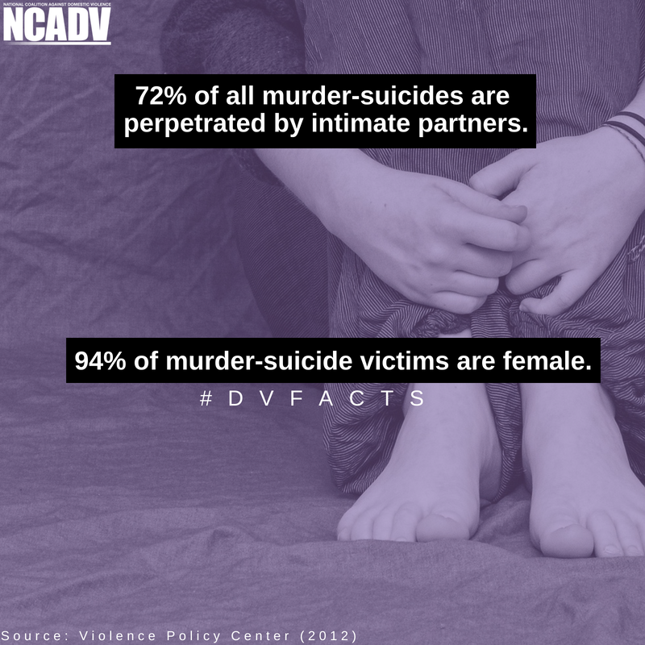
Homicide
• 1 in 2 female murder victims and 1 in 13 male murder victims are killed by intimate partners.
• A study of intimate partner homicides found 20% of victims were family members or friends of the abused partner, neighbors, persons who intervened, law enforcement responders, or bystanders.
• 72% of all murder-suicides are perpetrated by intimate partners.
• 94% of murder-suicide victims are female.
• Most intimate partner homicides are committed with firearms.

Slide 26
Many people try to cover up the abuse for a variety of reasons, and learning the warning signs of domestic abuse can help you help them:
Physical Signs:
  Black eyes
  Busted lips
  Red or purple marks on the neck
  Sprained wrists
  Bruises on the arms
Emotional Signs:
  Low self-esteem
  Overly apologetic or meek
  Fearful
  Changes in sleeping or eating patterns
  Anxious or on edge
  Substance abuse
  Loss of interest in once enjoyed activities and hobbies
  Talking about suicide
Behavioral Signs:
  Becoming withdrawn or distant
  Canceling appointments or meetings at the last minute
  Being late often
  Excessive privacy concerning their personal life
  Isolating themselves from friends and family

Slide 27
How to Help a Victim of Domestic Violence
Be Available for Them
If you decide to reach out to an abuse victim, do so during a time of calm. Getting involved when tempers are flaring can put you in danger. Also, make sure to set aside plenty of time in case the victim decides to open-up. If the person decides to disclose years of pent-up fear and frustration, you will not want to end the conversation because you have another commitment.
Start a Conversation
You can bring up the subject of domestic violence by saying “I’m worried about you because …..” or “I’m concerned about your safety…" or "I have noticed some changes that concern me...“
Listen Without Judgment
If the person does decide to talk, listen to the story without being judgmental, offering advice, or suggesting solutions. Chances are if you actively listen, the person will tell you exactly what they need. Just give the person the full opportunity to talk.
You can ask clarifying questions, but mainly just let the person vent their feelings and fears. You may be the first person in which the victim has confided.

Slide 28
Believe Domestic Violence Victims
Because domestic violence is more about control than anger, often the victim is the only one who sees the dark side of the perpetrator. Many times, others are shocked to learn that a person they know could commit violence.
Consequently, victims often feel that no one would believe them if they told people about the violence. Believe the victim's story and say so. For a victim, finally having someone who knows the truth about their struggles can bring a sense of hope and relief.
Offer the victim these assurances:
I believe you
This is not your fault
You don't deserve this.

Slide 29
Validate the Victim's Feelings
It's not unusual for victims to express conflicting feelings about their partner and their situation. These feelings can range from:
Guilt and anger
Hope and despair
Love and fear
If you want to help, it is important that you validate their feelings by letting them know that having these conflicting thoughts is normal. But it is also important that you confirm that violence is not okay, and it isn't normal to live in fear of being physically attacked.
Some victims may not realize that their situation is abnormal because they have no other models for relationships and have gradually become accustomed to the cycle of violence. Tell the victim that violence and abuse aren't part of healthy relationships. Without judging, confirm to them that their situation is dangerous, and you are concerned for their safety.
Offer Specific Support for Your Loved One
Help the victim find support and resources. Look up telephone numbers for shelters, social services, attorneys, counselors, or support groups. If available, offer brochures or pamphlets about domestic violence.

Slide 30
What Not to Do
Although there is no right or wrong way to help a victim of domestic violence, you want to avoid doing anything that will make the situation worse. Here are some "don'ts" the experts suggest you avoid:
Don't...
Bash the abuser. Focus on the behavior, not the personality.
Blame the victim. That's what the abuser does.
Underestimate the potential danger for the victim and yourself.
Promise any help that you can't follow through with.
Give conditional support.
Do anything that might provoke the abuser.
Pressure the victim.
Give up. If they are not willing to open-up at first, be patient.
Do anything to make it more difficult for the victim.

Slide 31
When to Call the Police About Domestic Violence
If you know that violence is actively occurring, call 9-1-1 immediately. If you hear or see physical abuse taking place, call the police. The police are the most effective way to remove the immediate danger to the victim and their children.
There are no situations in which children should be left in a violent situation. Do whatever is necessary to ensure their safety, even if it means going against the wishes of the victim or the wishes of the abuser.
Although your natural impulse may be to "rescue" someone you care about from domestic violence, the person being abused needs to make the ultimate decision of whether (and when) to leave and get help. Keeping this in mind will help ensure that you support them no matter their decision and continue to provide them with a loving and safe friendship.

Slide 32
Services Provided by The Help Restore Hope Center
24-Hour Hotline: Trained domestic violence Advocates provide 24 hour/7 days a week hotline coverage to assist callers needing immediate crisis intervention or support services. The hotline number is 1-855-966-9723.
6-Bed Safe Dwelling (Chenango) & 9-Bed Safe Dwelling (Madison): The on-call Advocate talks with the individual about their sheltering needs, can check capacity and available beds, and meet the individuals(s) to facilitate admission into the safe dwelling. Admission to the safe dwelling strictly follows guidelines outlined in 18 NYCRR Part 455, Standards for Domestic Violence Sponsoring Agencies and Safe Dwellings. This is a voluntary program that individuals can select to help meet their needs.
Information and Referral: Advocates develop and maintain a list of community resources in order to provide those seeking services with information and referrals specific to their self- identified needs (shelter, housing, mental health, DSS, employment assistance, drug, and alcohol services, etc.). Client confidentiality will be maintained unless a written release to exchange information is signed and authorized by the client.
General Advocacy: When appropriate the Advocate will provide advocacy and accompaniment for medical appointments and appointments with the County Department of Social Services, public and private housing for the purpose of securing alternate safe housing, and any other agency the individual may need access to in order to achieve safety.

Slide 33
Freedom Funds: The Freedom Fund is used for the purpose of assisting domestic violence and sexual assault survivors with staying free from violence. The funds can be utilized to purchase items/services that survivors may need to remain free from harm and independent from abuse. The items and services may include, but are not limited to food, hygiene and cleaning supplies, childcare costs, car repairs, and costs associated with obtaining personal documentation, security deposits, rental assistance, overdue bills, hotel stays, and transportation costs. Needs and assistance provision are determined on a case-by-case basis. This funding is provided by the United Way of Mid Rural NY.
Legal Advocacy: When appropriate, Advocates provide advocacy and accompaniment for victims of domestic violence and sexual assault with basic legal information and provides referrals in cases where clients need legal advice. Advocates can write Orders of Protection, Child Custody, Paternity, and other petitions for Family Court on an emergency and non-emergency basis. When possible, Advocates will accompany victims to court in a supportive role. In criminal cases, Advocates will accompany victims through the system as the victim interfaces with the District Attorney’s Office, Grand Jury, Police, and other related officials.
Counseling: Advocates provide crisis and short-term individual counseling for domestic violence survivors. Referrals for long term therapeutic counseling will be made to licensed mental health providers.

Slide 34
SANE Program: Sexual Assault Nurse Examiners (SANE) are specially trained and certified nursing professionals who seek to reduce the physical and psychological trauma of sexual assault, human trafficking, domestic violence, and intimate partner violence through sensitive and timely forensic medical examinations of victims. To ensure the highest quality of care, SANE collaborates closely with community response teams and participate in the judicial process.
Medical/Rape Crisis Accompaniment: Advocates meet sexual assault victims at area hospitals or police agencies to provide advocacy. Services are provided regardless of when the assault occurred and whether or not victims choose to report. Legal Advocacy available when needed.
Therapy: Provided by licensed therapists, Therapy is available for victims of domestic violence, sexual assault, and sexual abuse for both adults and children within the family system and for non-offending parents of child sexual abuse victims. Therapy sessions are confidential and are offered at no cost. The therapy interventions are short to midterm therapy, however; survivors are able to self-refer back to therapy as needed and may use the support group to help in their healing as well. Individual & Family therapy offerings and are Trauma-informed care based.
Support Groups: A support group for survivors of domestic violence will be facilitated by the Advocates. Survivors should call the hotline for intake into support group program through the Advocate that is on-call. The support group provides participants with a healthy and safe environment to build a support network and develop a rapport with other survivors.

Slide 35
OVS Crime Victim Services: Advocates assist crime victims in applying for NYS Office of Victim Services (NYSOVS) compensation. Compensation for medical bills, counseling, and many related expenses may be available to victims of domestic violence, sexual assault, and other violent crimes (survivor of DWI accident, robbery, etc.) if they meet specific criteria as determined by New York State.
Follow-up Services: With client permission, Advocates provide follow up services in the manner requested by the survivor. The intent of follow up services is to provide on-going supports and services for clients so that they may maintain stabilization and remain free from violence.
Community Outreach and Education: Advocates engage in community outreach and education activities to help inform the community and participating partners on the dynamics of domestic violence, sexual assault, dating violence and stalking. Advocates inform the community of services that are available for survivors and their families, and on prevention information. Informational brochures and pamphlets will also be distributed widely throughout the community with the intent of helping increase survivors to access services.
Safety Planning: A safety plan is a personalized, practical plan that includes ways to remain safe while in a relationship, planning to leave, or after the victim leaves. Safety planning involves how to cope with emotions, tell friends and family about the abuse, take legal action and more. A safety plan will have all of the vital information the victim needs and is tailored to their unique situation.

Slide 36

Need help call our hotline!
1-855-966-9723
Madison County Office
218 Liberty Street
Oneida, New York 13421
Tel: 315-363-0048
Chenango County Office
26 Conkey Avenue
Norwich, New York 13815
Tel: 607-334-7779

